Slide 1
Technology | Agriculture | Business

Slide 2
The Company
Palatehub Limited applies information technology to crop production and livestock farming for increased productivity, product diversification and value addition.

Slide 3
The Problem
Small-scale poultry farmers struggle to attain profitability and sustainability, despite an estimated excess demand of 20million birds (APP, 2016) and a market-size of N890billion in consumption (NBS, 2019)

Slide 4
The proposed solution
An Enterprise Management Software that establishes and monitors best-practices (in the form of Standard Operating Procedures) to reduce costs and improve yields based on farm data that we collect on a continuous basis. The EMS also provides access to relevant knowledge, production inputs and markets.

Slide 5
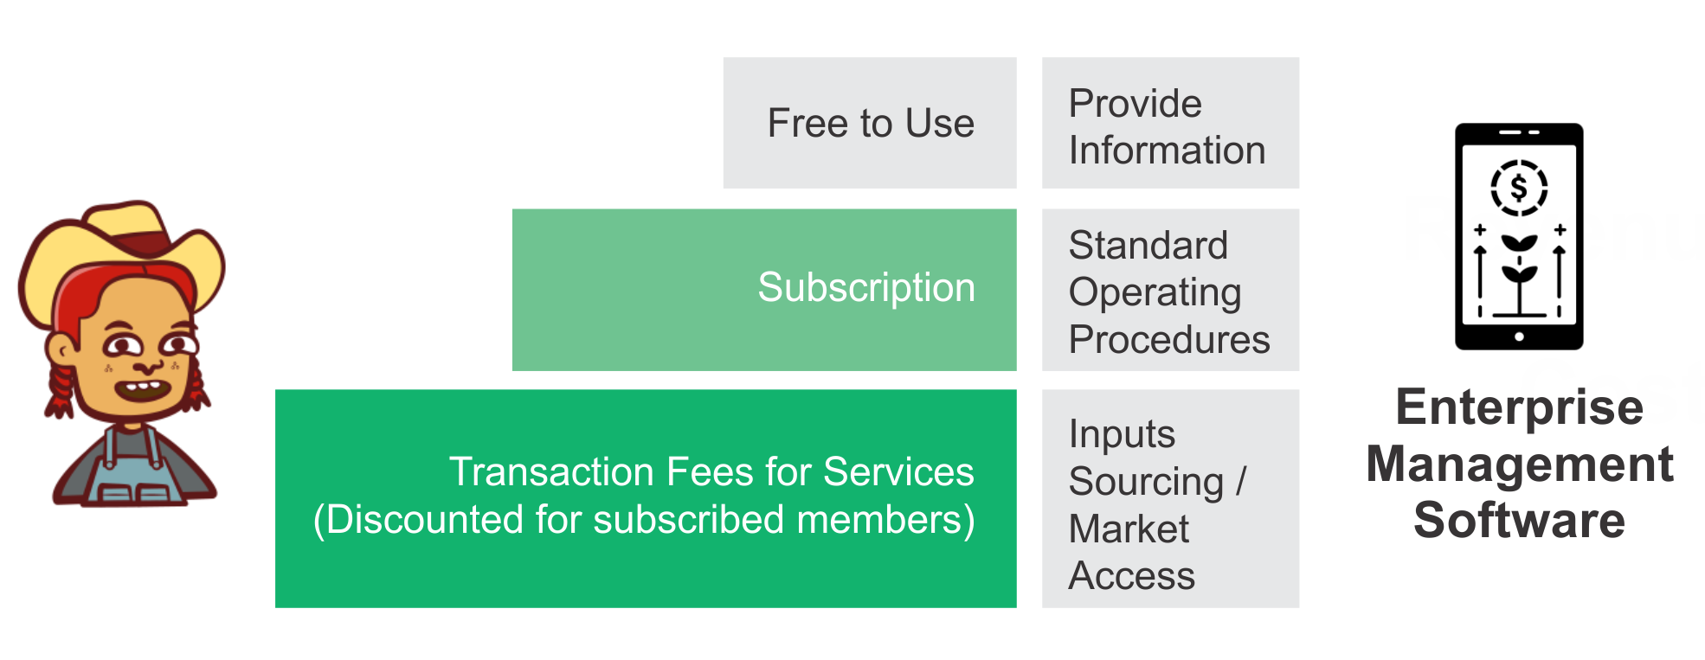
Our Business Model

Slide 6
The Competition
Current ways the Nigeria target market solves the challenges | Other African Agritech companies in the same space | Companies with the same service offering
Self-Help (Youtube, Google etc.) | FarmCrowdy (www.farmcrowdy.com) Crowd Sourcing | Cropin (www.cropin.com) Data Analysis
Use of Consultants | Thrive Agric (www.thriveagric.com) Farm Services | PoultryApp (www.poultryapp.com) Farm Management
Use of MS Excel and other Accounting applications | Probity Farms (www.probityfarms.com) Farm Services | NavFarm (www.navfarm.com) Farm Management

Slide 7
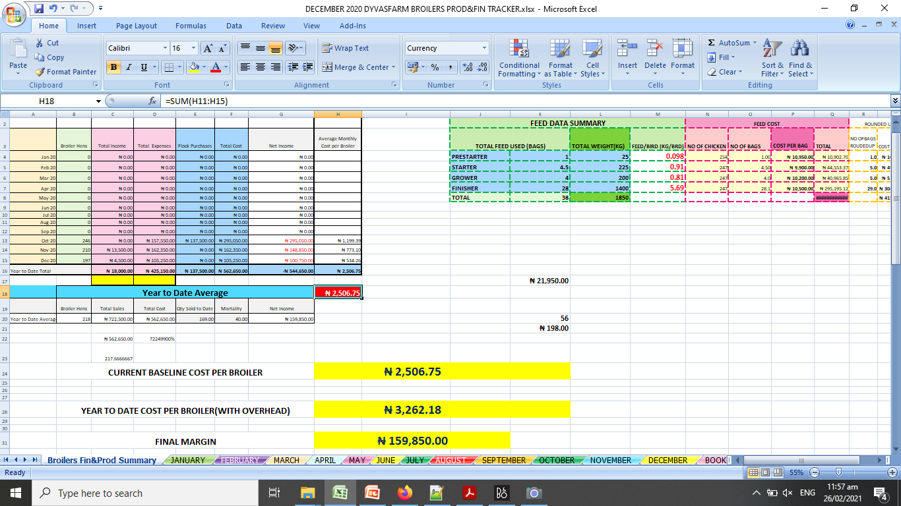
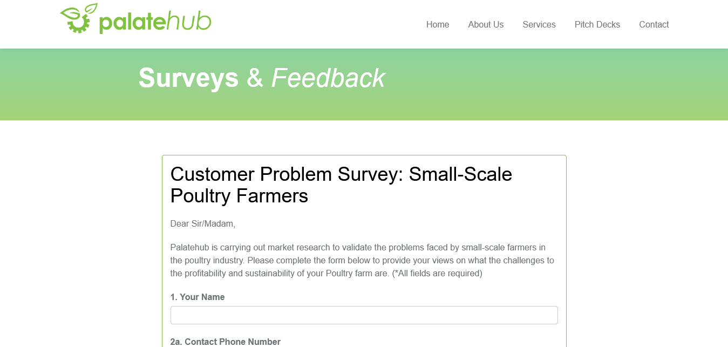
Traction
R&D: Baseline Data
R&D: Continuous Data Gathering
Revenue Generation MVP - Gallus web application
Customer Acquisition
Capital & Funding

Slide 8
Financials
 | Month 1 | Month 6 | Month 12
Total Number of Customers Acquired | 300 | 605 | 1,400
Farm Size (total number of birds) | 60,000 | 121,000 | 280,000
Subscription revenue per customer per month | N2,000 | N2,000 | N2,000
Fees from Services revenue per customer | N20,016.67 | N20,016.67 | N20,016.67
Total Revenue for the month | N6.6million | N13.3million | N30.8million
Notes:
NGN192million (USD384,000) in total revenue in the first year. NGN502.5million (USD1million) in eighteen months

Slide 9
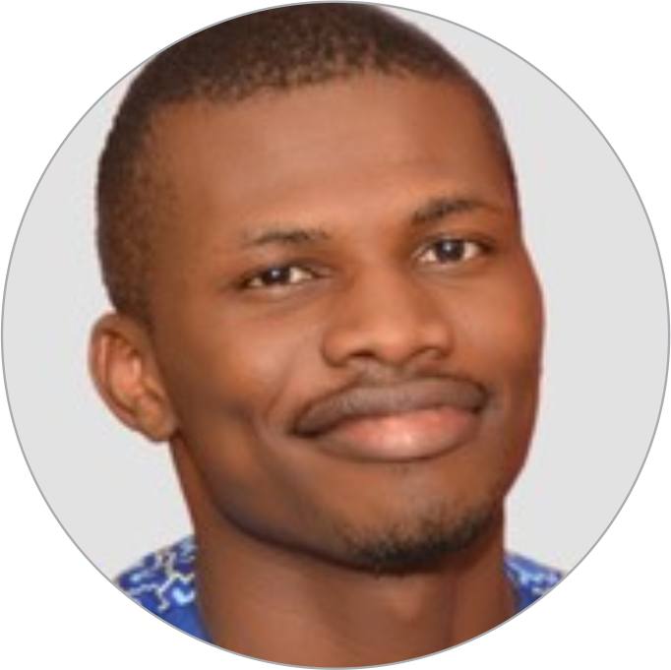
Our Team
Bunmi Alaran
Opeyemi Alaran
Olufemi Dawodu
Entrepreneur. Business Development Expert.
5+ years experience.
Chartered Accountant. Project Manager. Economist. Web Developer. 10+ years experience
Entrepreneur. Mechanical Engineer. 25+ years experience.

Slide 10
Funding
We are looking USD200,000 in funding to acquire 1,400 customers, complete the development our minimum viable product, develop a prototype farm and establish service facilities.
$200k Angel Round
Initial Investment Opportunity
$1m Revenue
Over eighteen months

Slide 11
Summary
Farmers face challenges to their profitability and sustainability
We are building an enterprise management software to resolve or reduce these challenges (knowledge gap, skill gap, market forces)
Our Business model is a combination of subscription and transaction fees
We estimate we will achieve $1m in total revenues in 18 months
We have a strong team
We are asking for $200k in pre-seed capital to acquire 1,400 customers, complete the development our minimum viable product, develop a prototype farm and establish service facilities

Slide 12
Thank you
Palatehub Limited
1st Floor, Abbey Building,
51 Okota Road, Okota-Isolo, Lagos, Nigeria.
Website: www.palatehub.com
Email: opeyemi@palatehub.com
Facebook: @palatehub Twitter: @palatehub Linkedin: company/palatehub
Cover image created by pch.vector - www.freepik.com

